Slide 1
Look at program using recursion with LL
3rd-ConWriteAssendDesc
CountUp
CountDown

Slide 2
Look at: B raised to the power of P 4th-RecurBtoP
Creates a class PowersRecursion, with a method, raiseToPower, that takes two integer parameters named B (base) and P (power), and will return the value of B^{P}. (for example, PowersRecursion(2,3) = 8, PowersRecursion(3,2) = 9, etc)
Only works for non-negative, whole numbers.
Program introduces idea of a public interface method, which in turn uses a private recursive interface

Slide 3
public int raiseToPower(int baseValue, int power)
// this is the public interface, which will validate
// input and in general, do things that only need to be
// done once, not in the recursion.
// It calls a private recursive method to do the work
return sign * raiseToPowerPrivate(baseValue, power);
// after all setup, we finally call the private recursive method, and let its return just pass right thru this method’s return (correcting the sign if need be)
private int raiseToPowerPrivate(int baseValue, int power)
// this is the private recursive method
// which will call itself

Slide 4
Factorial – Classic Recursion Problem 5th-RecurFactorial
Watch at: http://www.cs.usfca.edu/~galles/visualization/RecFact.html
Not much code to do this one!
Factorial is defined as:
Factorial(0) = 1
Factorial(N) = N * Factorial(N-1)
Very much like you saw in the pre-word videos

Slide 5
Recursion with Linked List
6th-RecurPrintingLL
Using recursion for LL walking, quite useful!

Slide 6
Another classic example of recursion 7th-RecFibonaccic
implement the Fibonacci series
The Fibonacci code should write out the terms in the Fibonacci series, using recursion.
Fibonacci numbers are defined as follows:
Fibonacci(0) = 0
Fibonacci(1) = 1
Fibonacci(N) = Fibonacci(N – 1) + Fibonacci(N – 2)
This is the homework

Slide 7
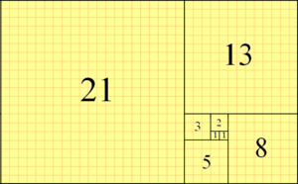
Fibonacci in geometry

Slide 8
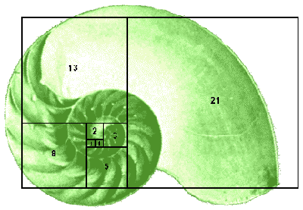
Fibonacci in nature

Slide 9
As you call down to the next level, your new answer becomes the n-1, and your n-1 becomes the n-2
0
1
1 | n-2= | 0 | n-1= | 1
2 |  |  | n-2= | 1 | n-1= | 1
3 |  |  |  |  | n-2= | 1 | n-1= | 2
5 |  |  |  |  |  |  | n-2= | 2 | n-1= | 3
8 |  |  |  |  |  |  |  |  | n-2= | 3 | n-1= | 5
13
21
This level’s n-1 becomes
The next level’s n-2
This level’s answer becomes
The next level’s n-1

Slide 10
Recursion Versus Iteration
Look at 8th-BtoP-Iterat-Recur

